Slide 1
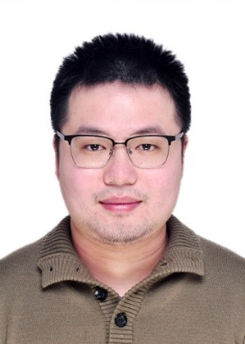
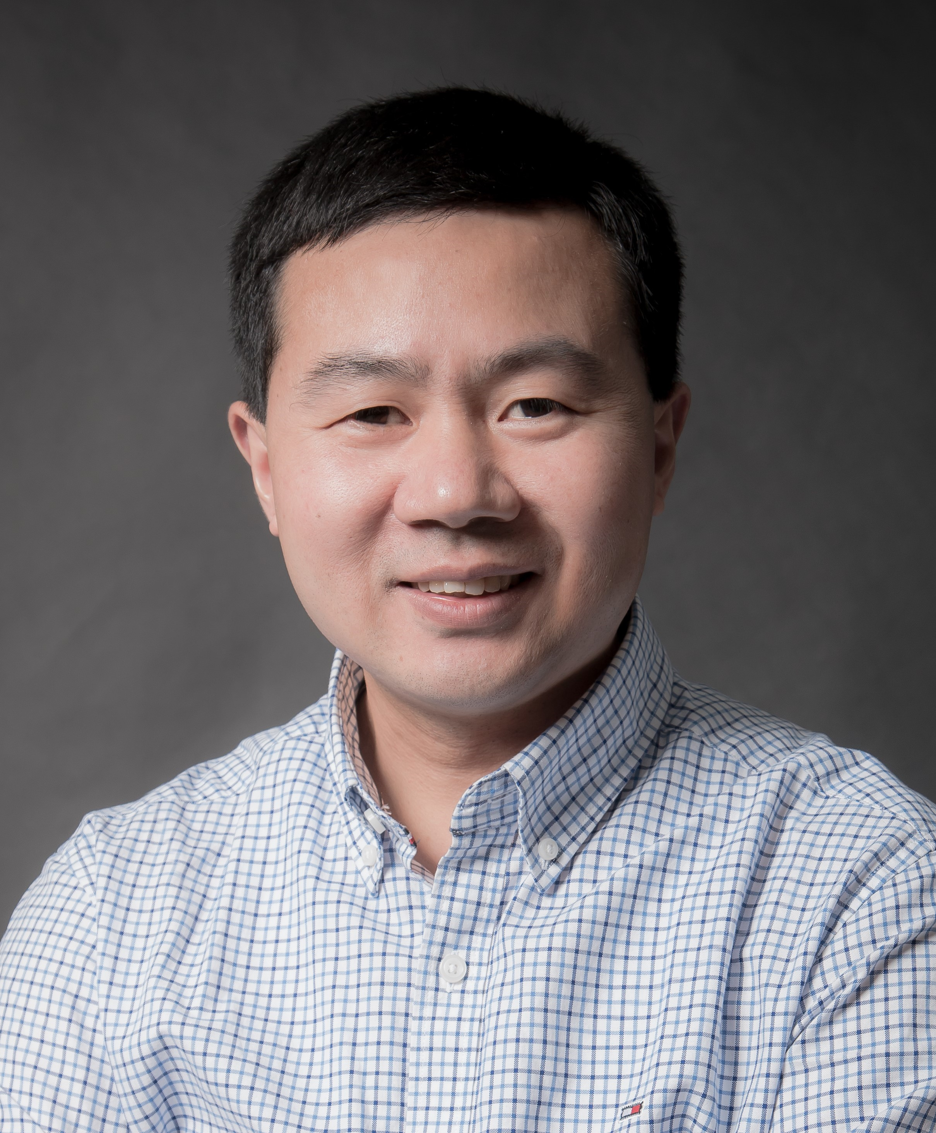
DMRG study of superconductivity of Hubbard model with electron-phonon interaction
Hao-Xin Wang
Tsinghua University
March 14th , 2020
Collaborators:
Yifan Jiang
Hong Yao
Notes:
Dear All, good morning, My name is Hao-Xin. Thanks for listening my talk about our recent study of the superconductivity of Hubbard model with electron-phonon interaction.This work is collaborated with Professor Yifan Jiang, and My advisor Hong Yao.Thanks for they contribution to this project.

Slide 2
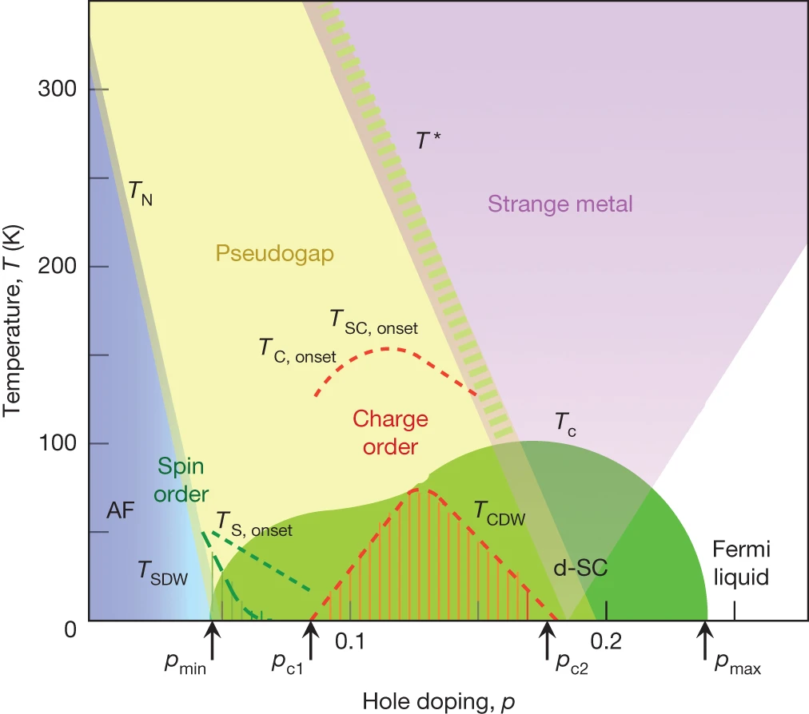
Introduction
It is a promising consensus to understand the rich non-Fermi-liquid behaviors in unconventional superconductor (e.g. Cuprate) from the physics of the doping of a Mott insulator.
Although under debate, growing numeric researches suggest doping the simplest one-band Hubbard model gives an insulating stripe states.[Absence of superconductivity in the pure two-dimensional Hubbard model, Phys. Rev. X 10, 031016, Mingpu Qin et al.]
Thus, it is indispensable to introduce further terms if one want to obtain a d-wave superconductor state when doping, for example, next nearest neighbor hopping t₂, or electron-phonon interaction.
Cuprate phase diagram
(from doi:10.1038/nature14165)
Notes:
So, as beginning, I will give an introduction about the theoretic research about High Tc superconductivities. As we can see, the most phases in Cuprate
include SC, strange metal,are not understood up to now. It’s a promising……
consensus /kənˈsɛnsəs/
The simplest model to describe the strongly correlated fermion systems, is the single-band hubbard model.
Although….
Thus….

Slide 3
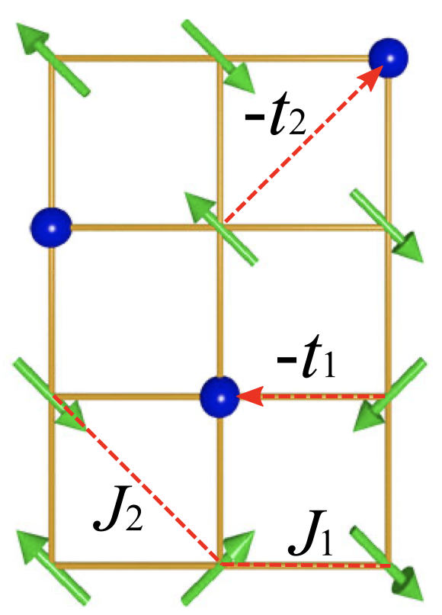
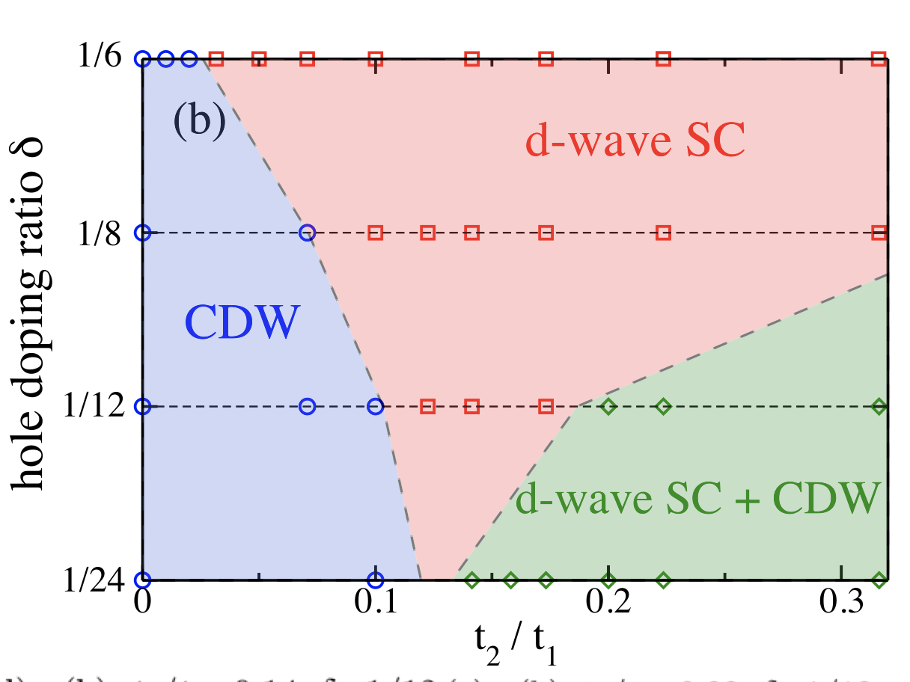
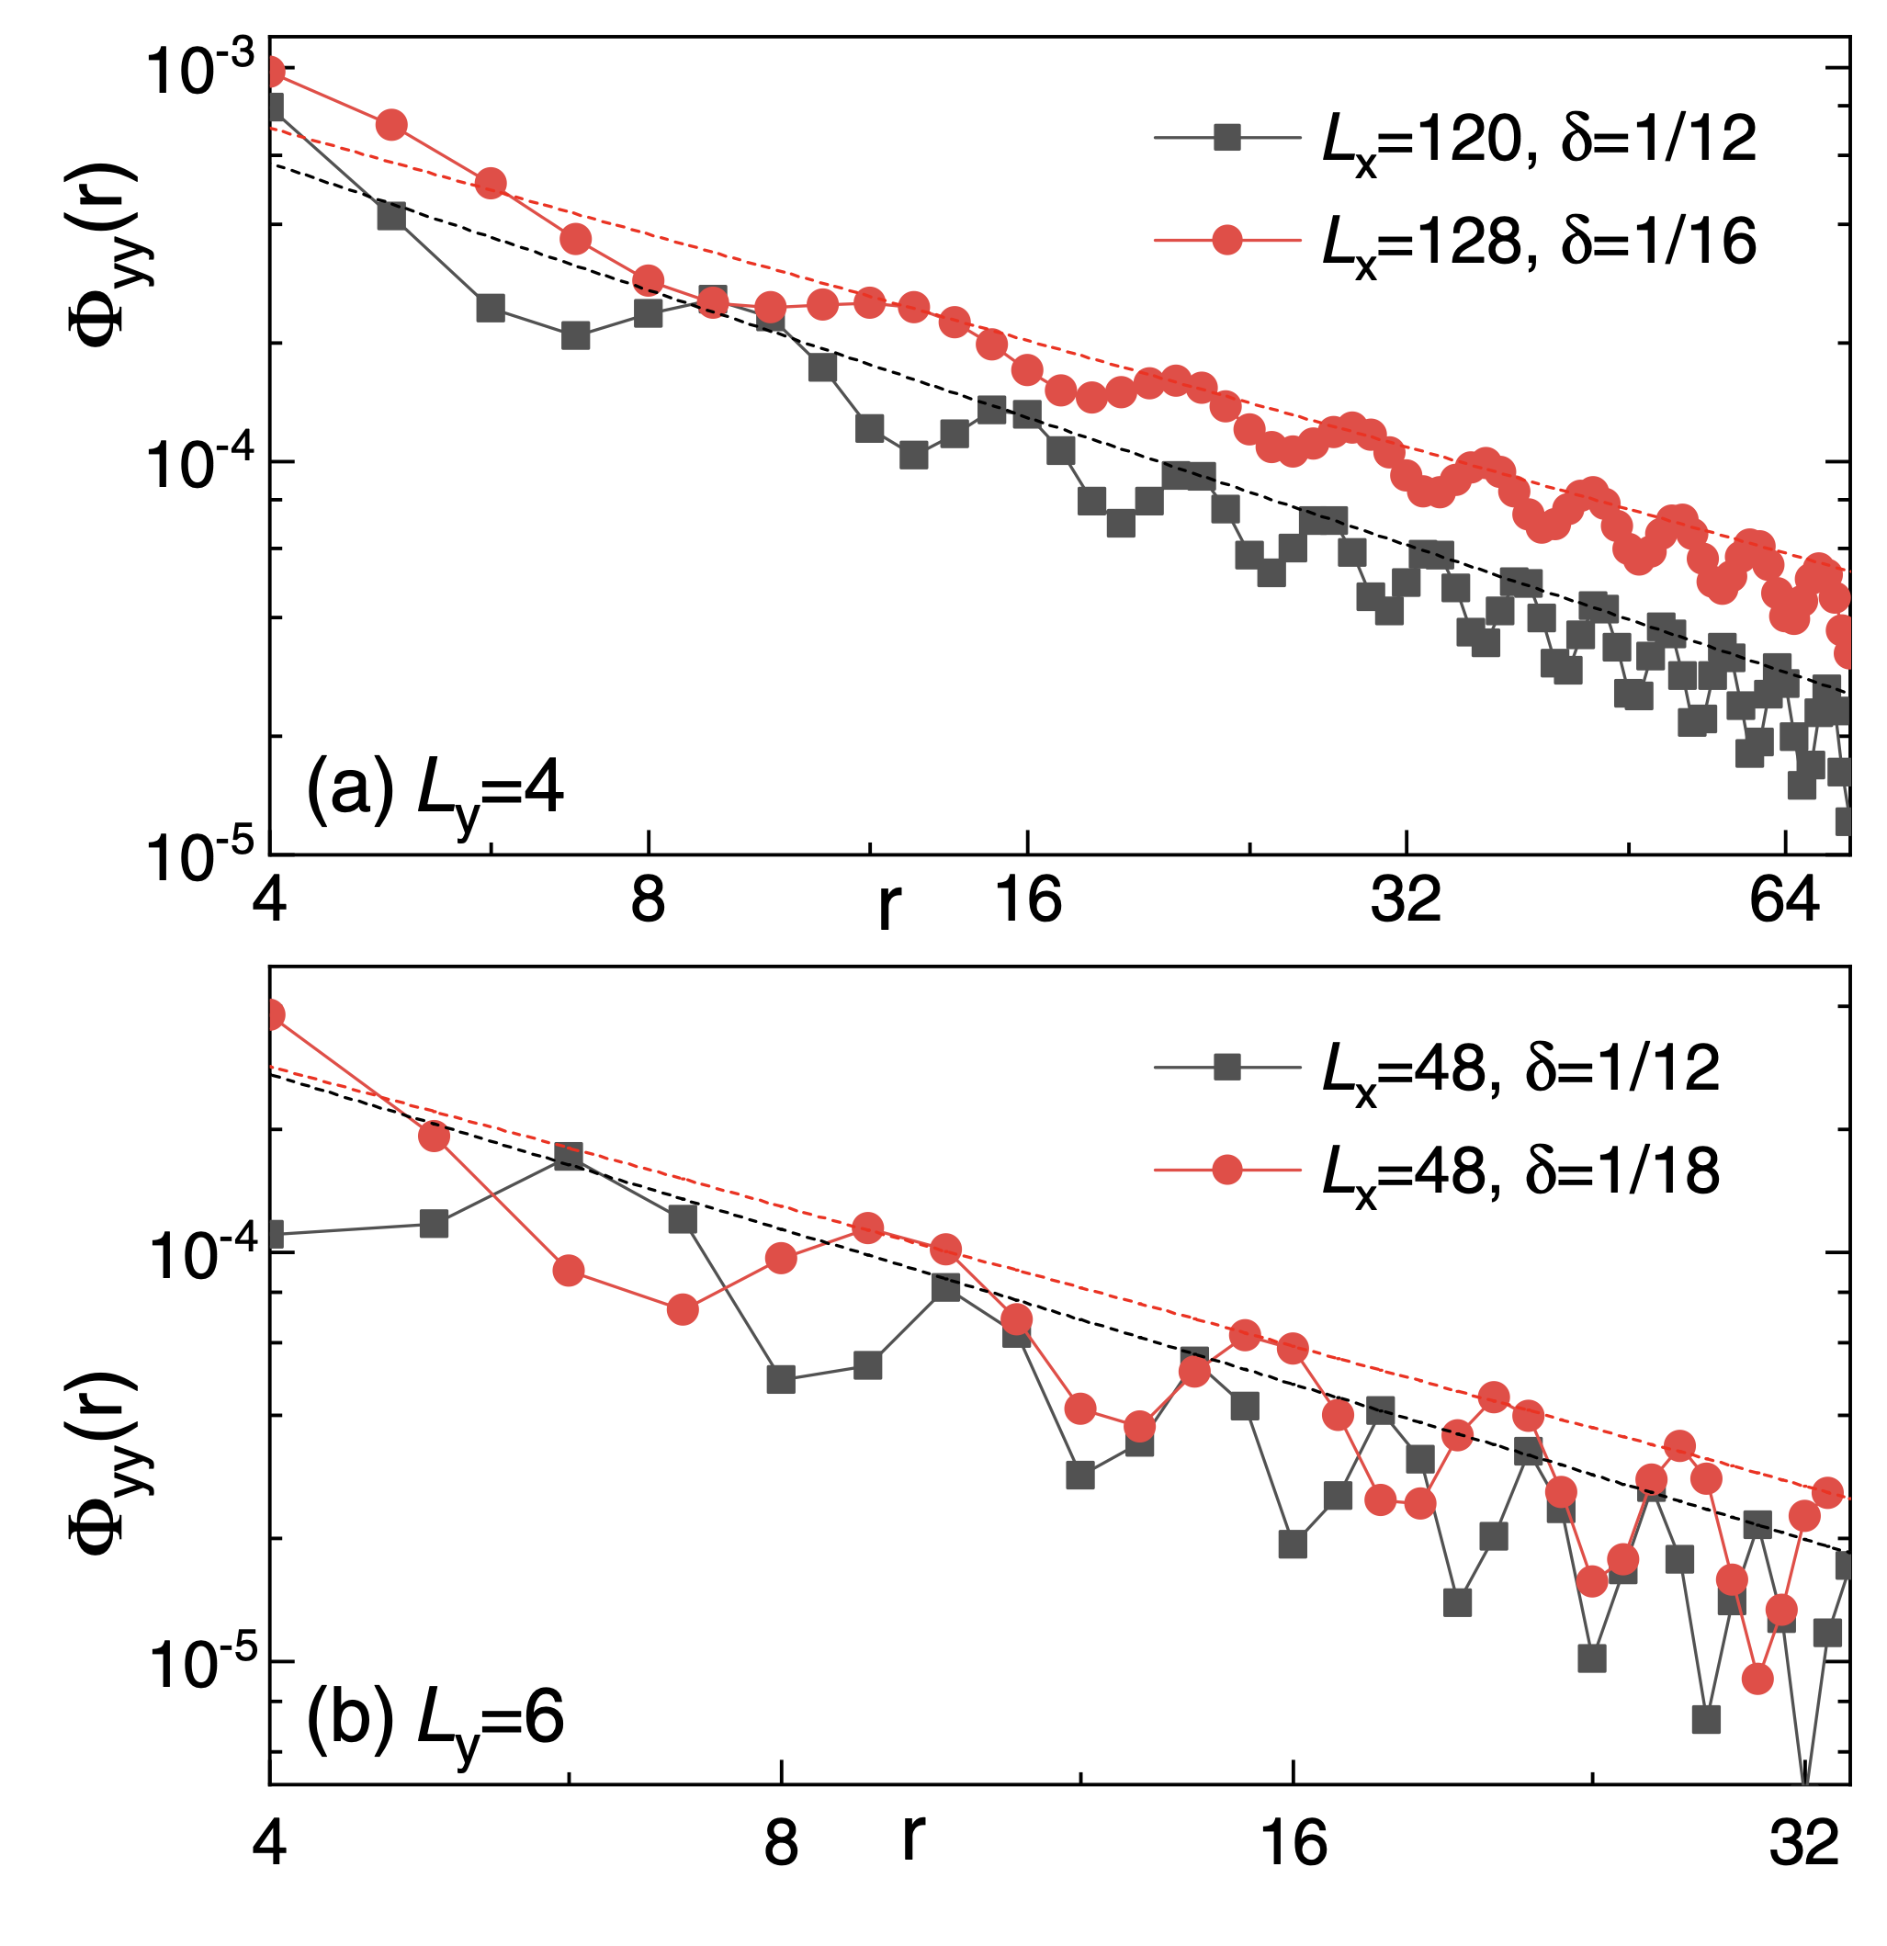
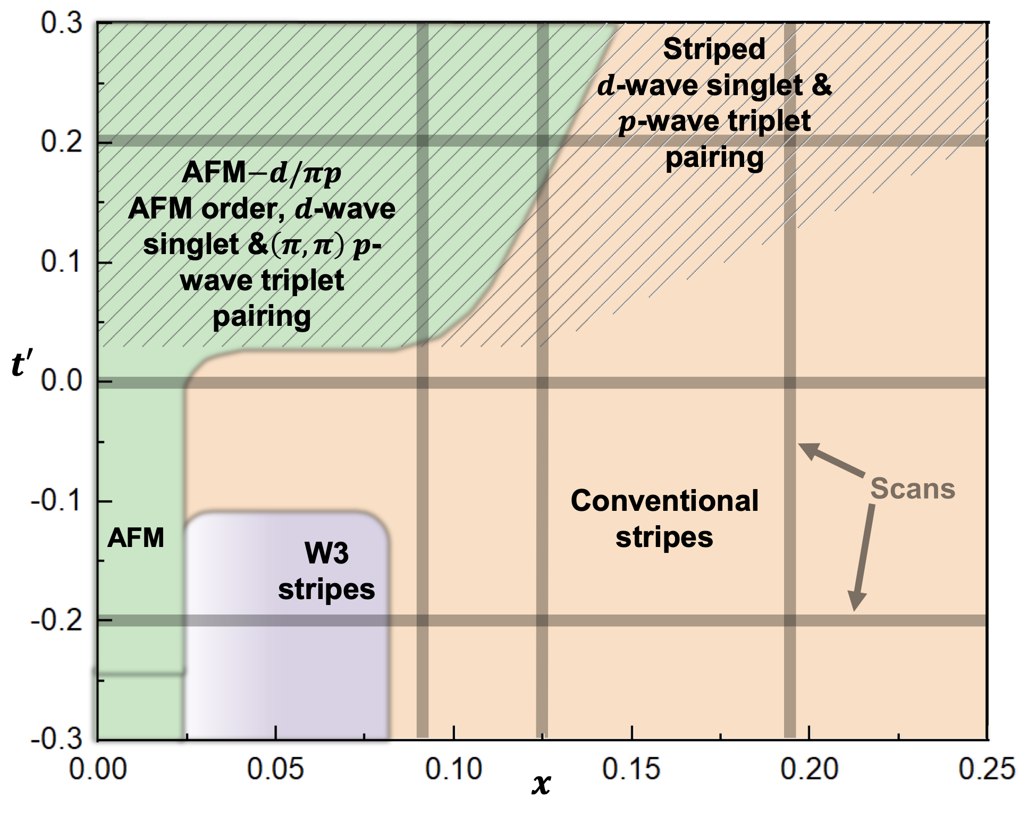
Extra terms beyond Hubbard
next nearest neighbor hopping t₂
dope the J1-J2 spin liquid
Hong-Chen Jiang and Steven A. Kivelson Phys. Rev. Lett. 127, 097002
copy from Phys. Rev. Lett. 127, 09700, Shoushu Gong, et al.
Ground-state phase diagram of the t-t′-J model , Shengtao Jiang et al.
Notes:
There have been some researches investigated the further range terms in Hubbard or t-J models. One is the NNN hopping t2. In a DMRG research, the author suggests a positive t2 will drive a d-wave superconduct state, or mixing with CDW phase. Another calculation confirm this results, but they also shows with a negative t2, corresponding to the hole dope in Cuprate, can not give a SC state.
And there is also a work that dope a J1J2 spin liquid. It indicates a quasi long range superconductor order at lightly doping level.

Slide 4
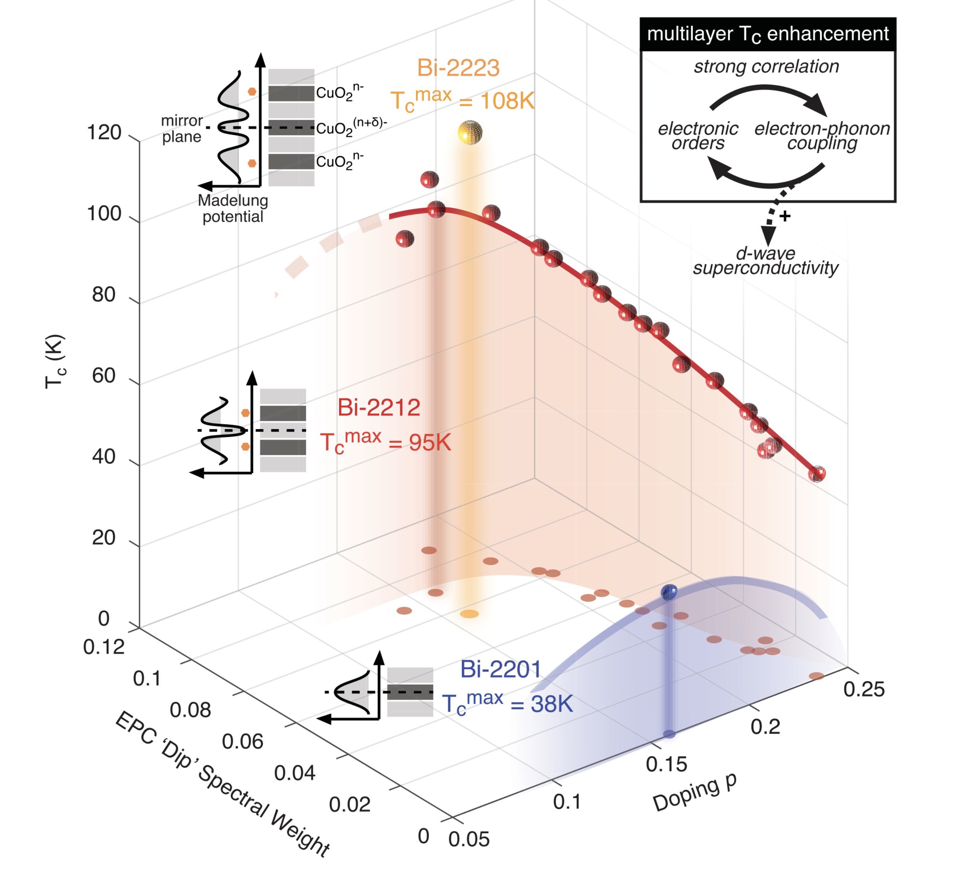
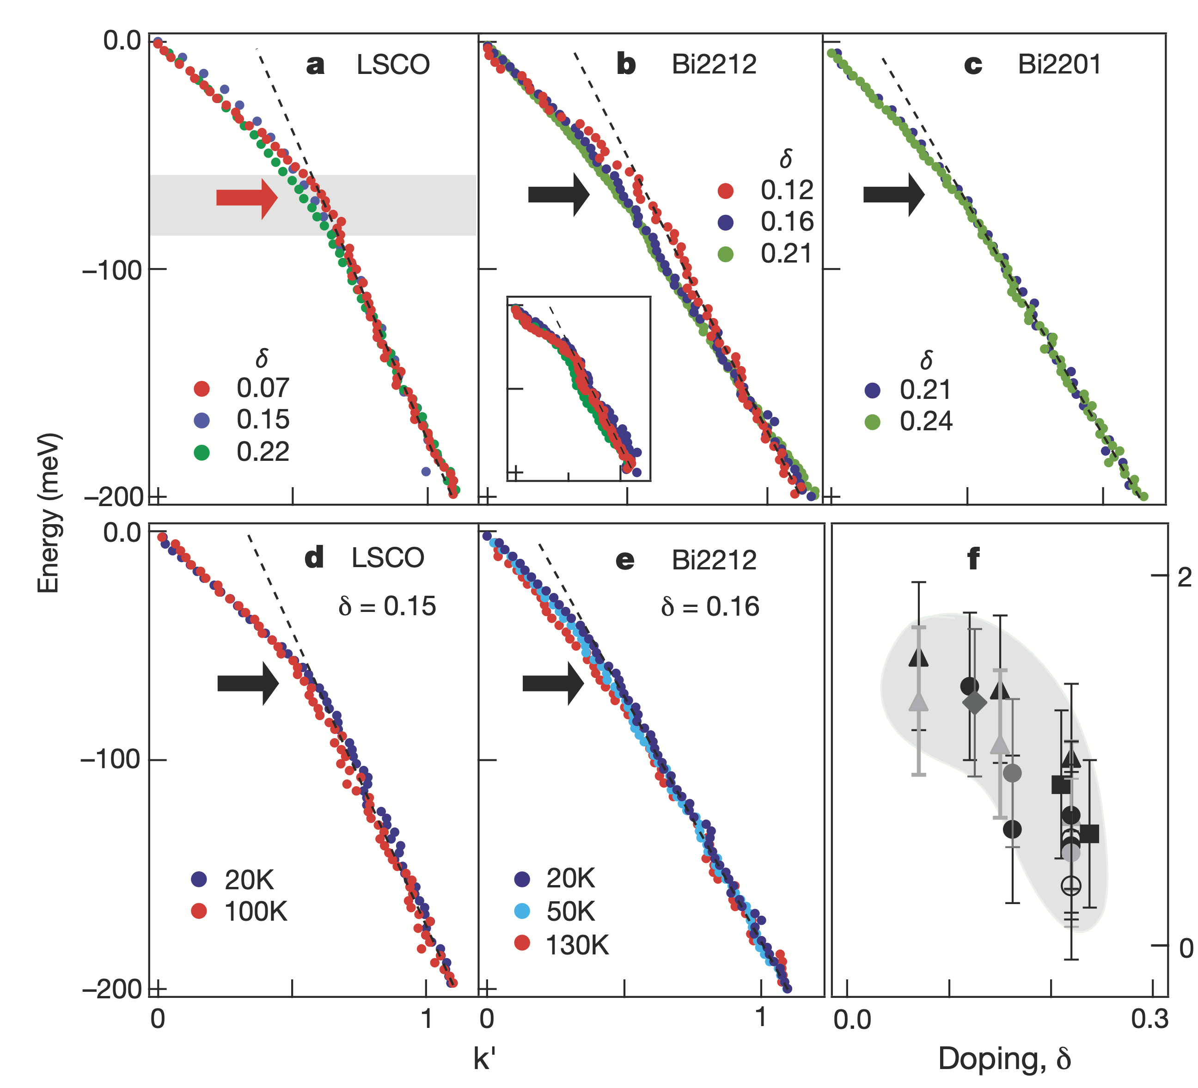
Electron-Phonon Coupling(EPC)
EPC drives the formation of Cooper pairs in conventional superconductivity.
Increasing experiments indicate that EPC can be an essential ingredient in high T_{c} superconductors, including cuprates and iron-based superconductors.
intertwined growth of the superconductivity and EPC
[ He et al.,Science362,62–65 (2018) ]
ubiquitous EPC in cuprates
[Nature (London) 412, 510 (2001)]

Slide 5
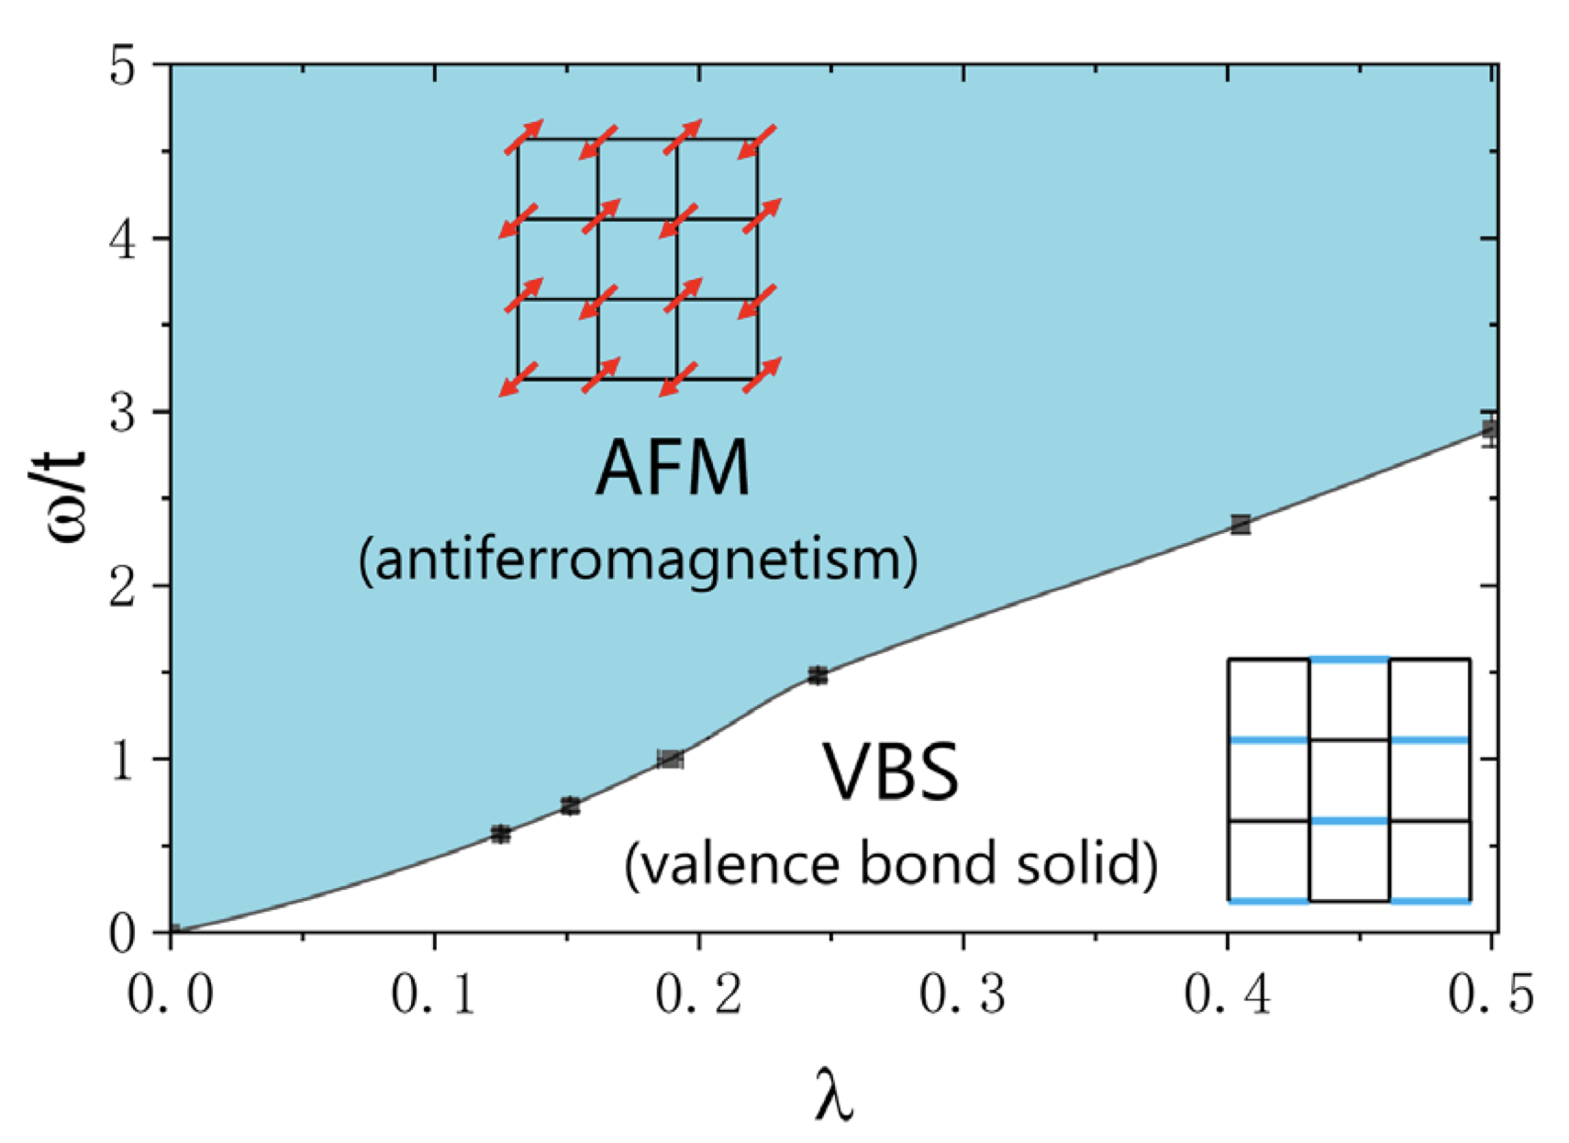
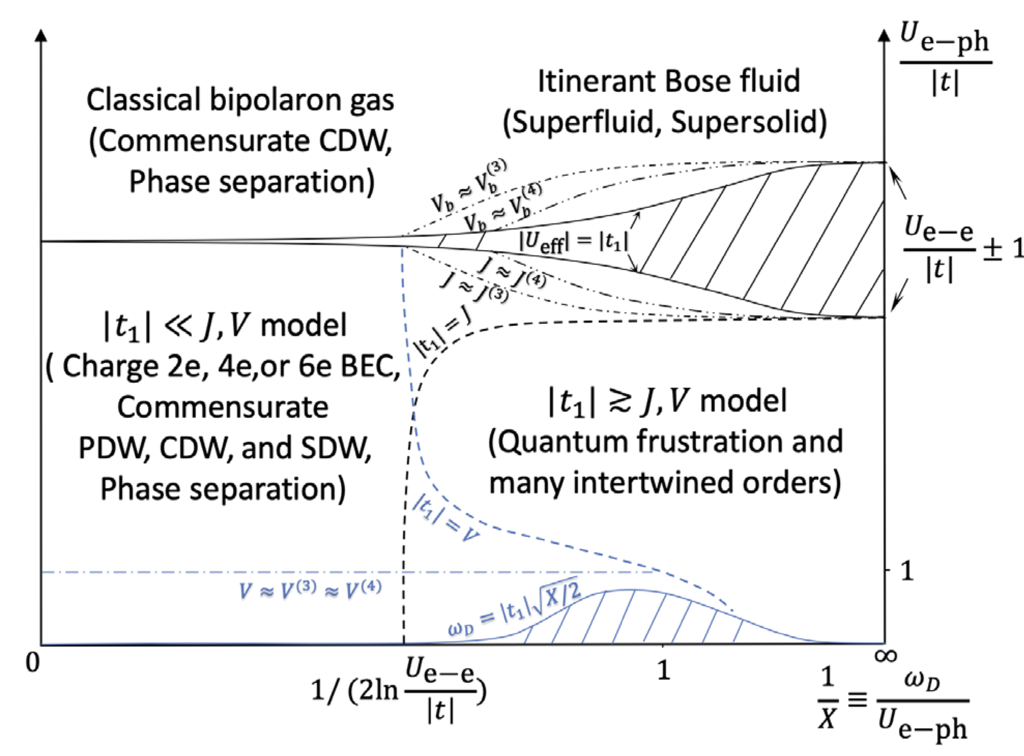
Electron-Phonon Coupling(EPC)
Theoretical studies also suggest EPC can drive some exotic phase such as pair-density wave and antiferromagnetism.
Su-Schrieffer-Heeger Model
Holstein-Hubbard Model
Xun Cai, Zi-Xiang Li, and Hong Yao
Phys. Rev. Lett. 127, 247203 (2021)
Z. Han, S. A. Kivelson, and H. Yao, Phys. Rev. Lett. 125,
167001 (2020).
Question: if EPC can drive d-wave superconductivity in a doped one-band Hubbard model?

Slide 6
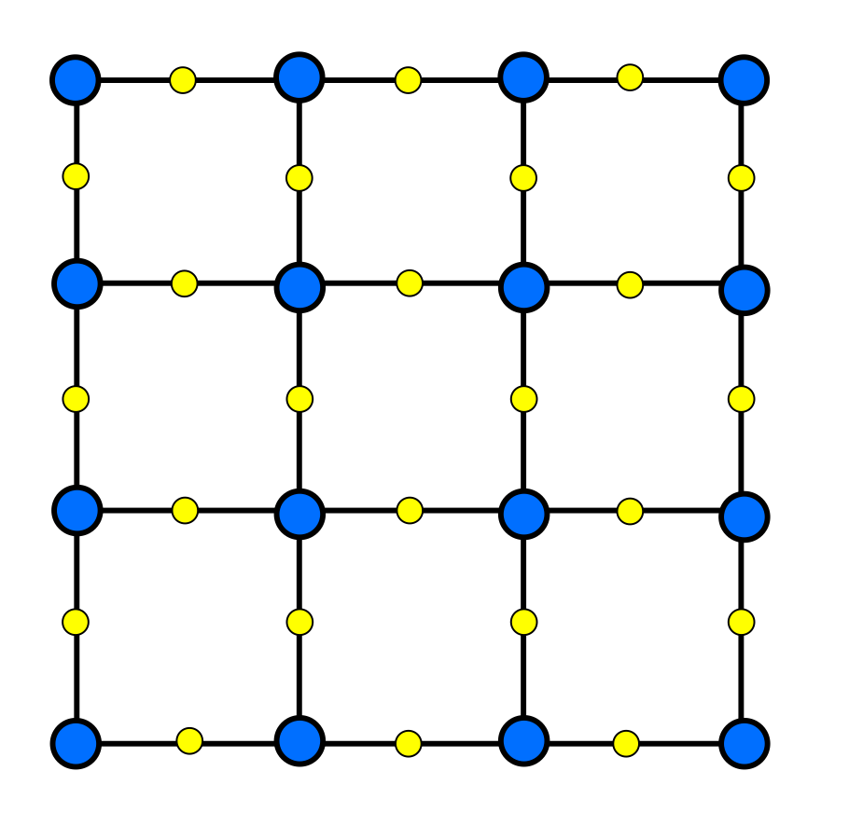
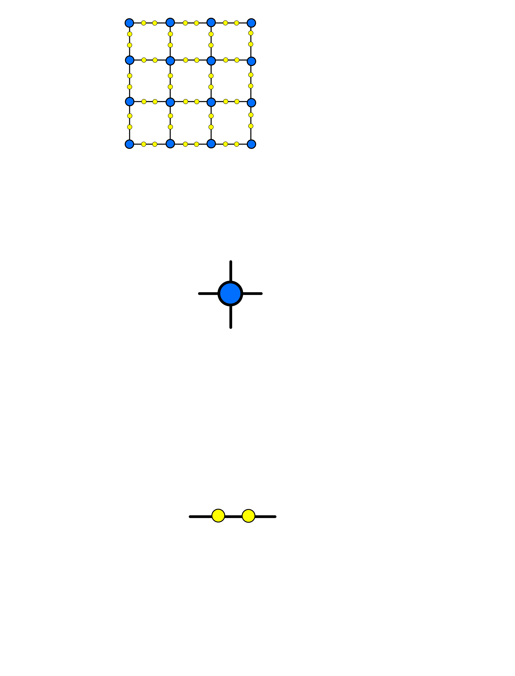
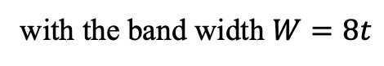
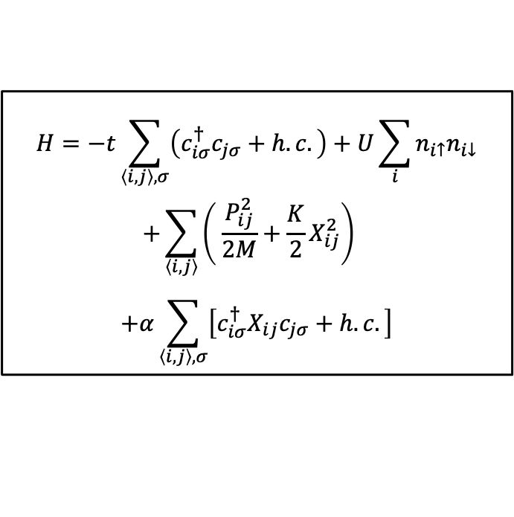
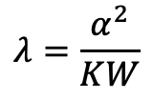
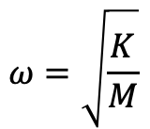
Su-Schrieffer-Heeger(SSH)-Hubbard model
$$H=−t\sum_{\left\langle i,j\right\rangle ,σ}{\left(c_{iσ}^{†}c_{jσ}+h.c.\right)}+U\sum_{i}{n_{i↑}n_{i↓}}$$
$$+\sum_{\left\langle i, j\right\rangle }{\left( \frac{P_{ij}^{2}}{2M}+\frac{K}{2}X_{ij}^{2}\right)}$$
$$+α\sum_{\left\langle i, j\right\rangle ,σ}{\left[c_{iσ}^{†}X_{ij}c_{jσ}+h.c.\right]}$$
$$ω=\sqrt{\frac{K}{M}}$$
Phonon frequency:
The dimensionless EPC constant:
$$λ=\frac{α^{2}}{KW}$$
with the band width $W=8t$
Electron site (Cu)
The model can be regarded as an approximate realistic model of CuO₂ plane.
Phonon site (O)

Slide 7
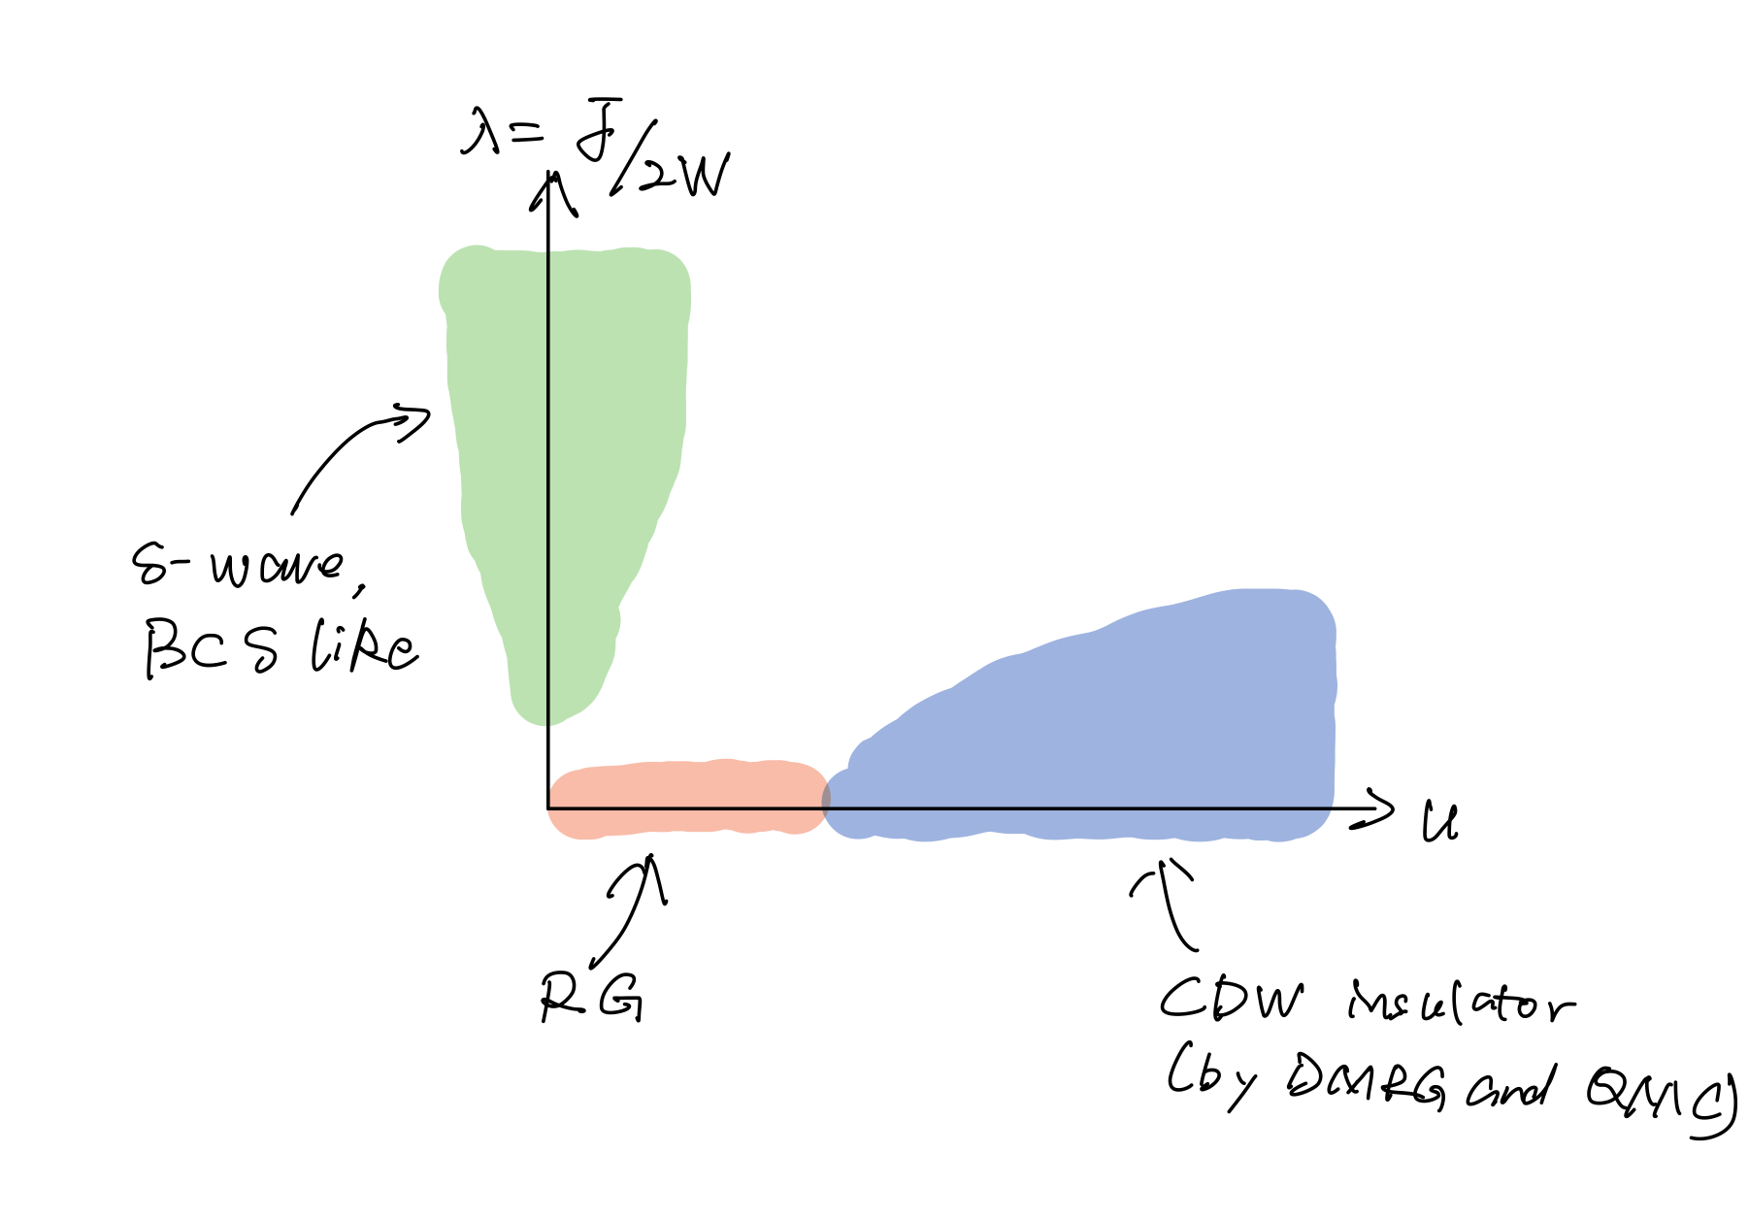
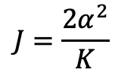
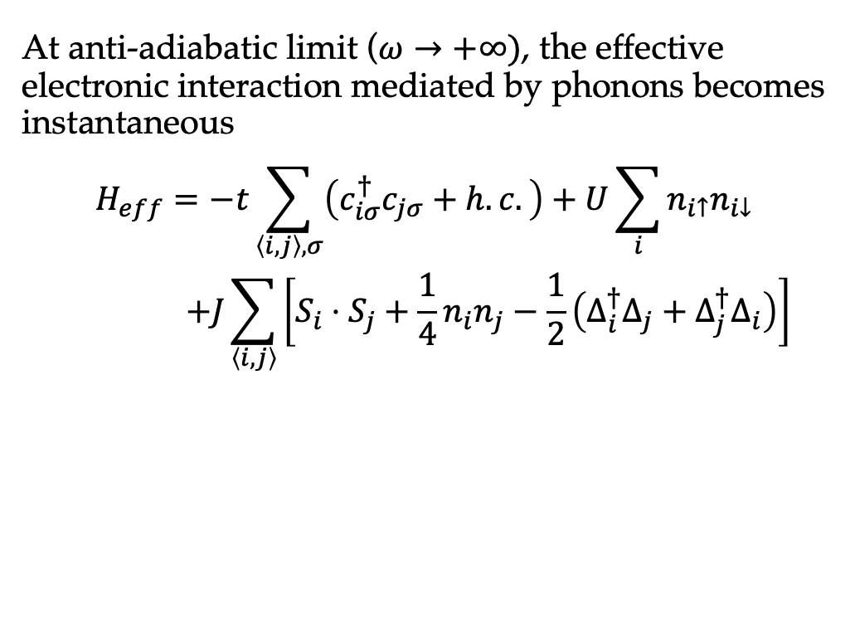
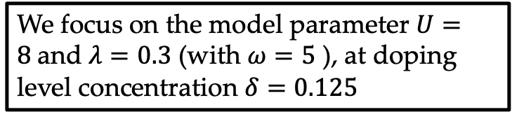
Su-Schrieffer-Heeger(SSH)-Hubbard model
At anti-adiabatic limit ($ω→+∞)$, the effective electronic interaction mediated by phonons becomes instantaneous
$$H_{eff}=−t\sum_{\left\langle i,j\right\rangle ,σ}{\left(c_{iσ}^{†}c_{jσ}+h.c.\right)}+U\sum_{i}{n_{i↑}n_{i↓}}$$
$$+J\sum_{\left\langle i, j\right\rangle }{\left[S_{i}⋅S_{j}+\frac{1}{4}n_{i}n_{j}−\frac{1}{2}\left(Δ_{i}^{†}Δ_{j}+Δ_{j}^{†}Δ_{i}\right)\right]}$$
$$J=\frac{2α^{2}}{K}$$
J-term favors on-site pairing and on-bond pairing
on-site Coulomb repulsion will suppress the on-site pairing
We focus on the model parameter $U=8$and $λ=0.3$ (with $ω=5$ ), at doping level concentration $δ=0.125$

Slide 8
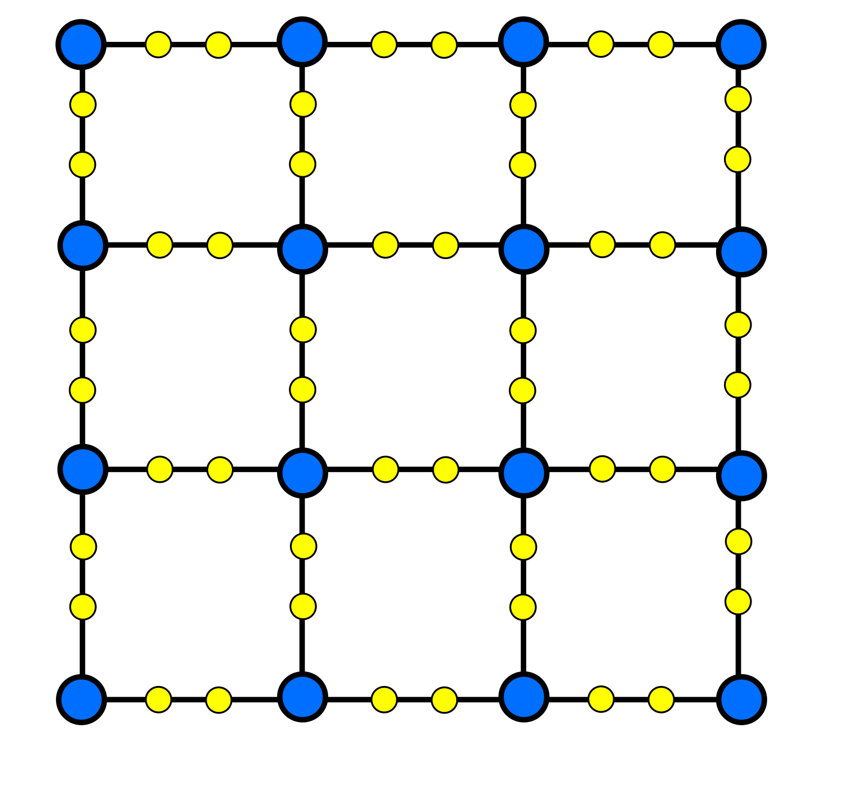
Algorithm
Density matrix renormalization group (DMRG)
[White, S. R., 1992, Phys. Rev. Lett. 69, 2863. ]
Phonon pseudo-sites are introduced to reduce calculation costs.
[Eric Jeckelmann and Steven R. White, 1998, Phys. Rev. B 57, 6376 ]
Perturbation as in single site algorithms is indispensable since hopping and interaction is actually very long range in DMRG [White, S. R., 2005, Phys. Rev. B 72, 180403(R) ]
We also keep two site update to gain the precisions.
Large scale parallel technique(OpenMP & MPI) are adopted to accelerate the calculation.
Phonon pseudo-site

Slide 9
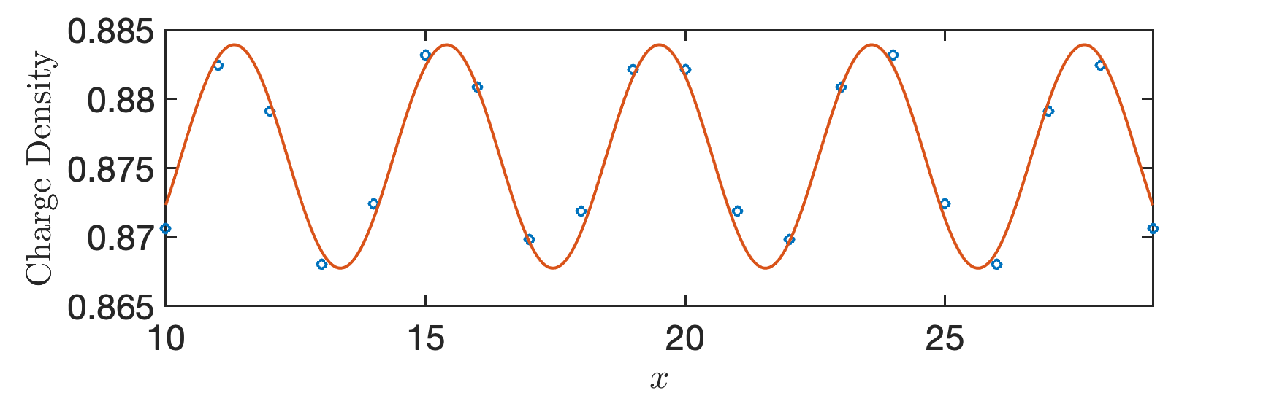
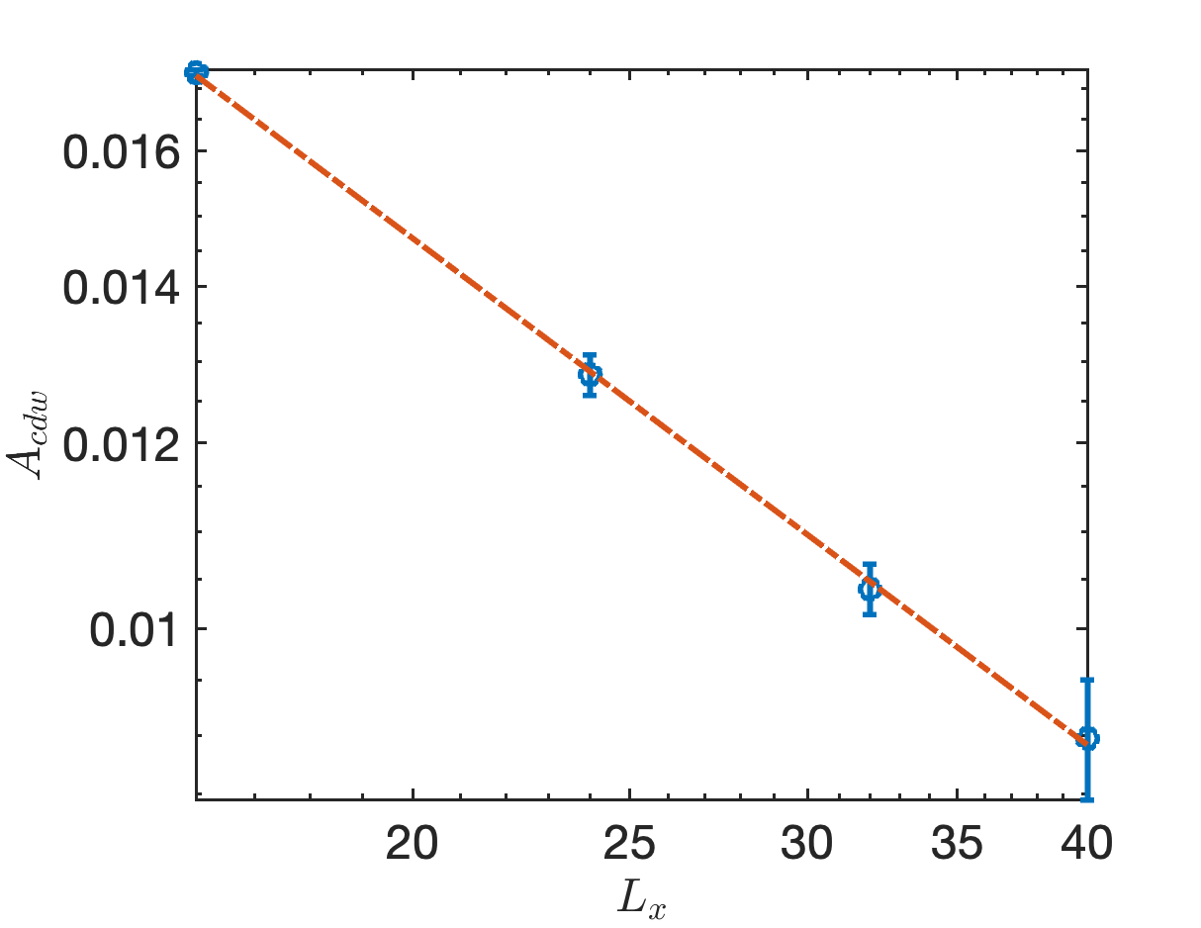
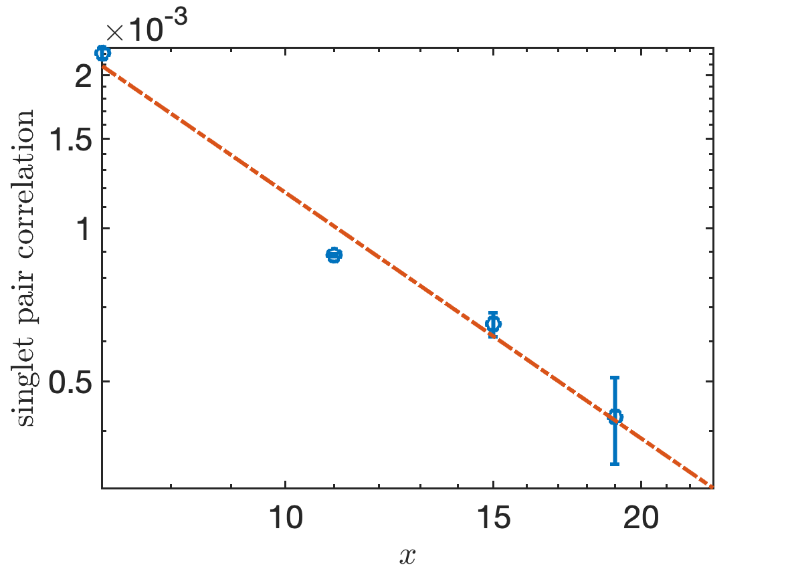
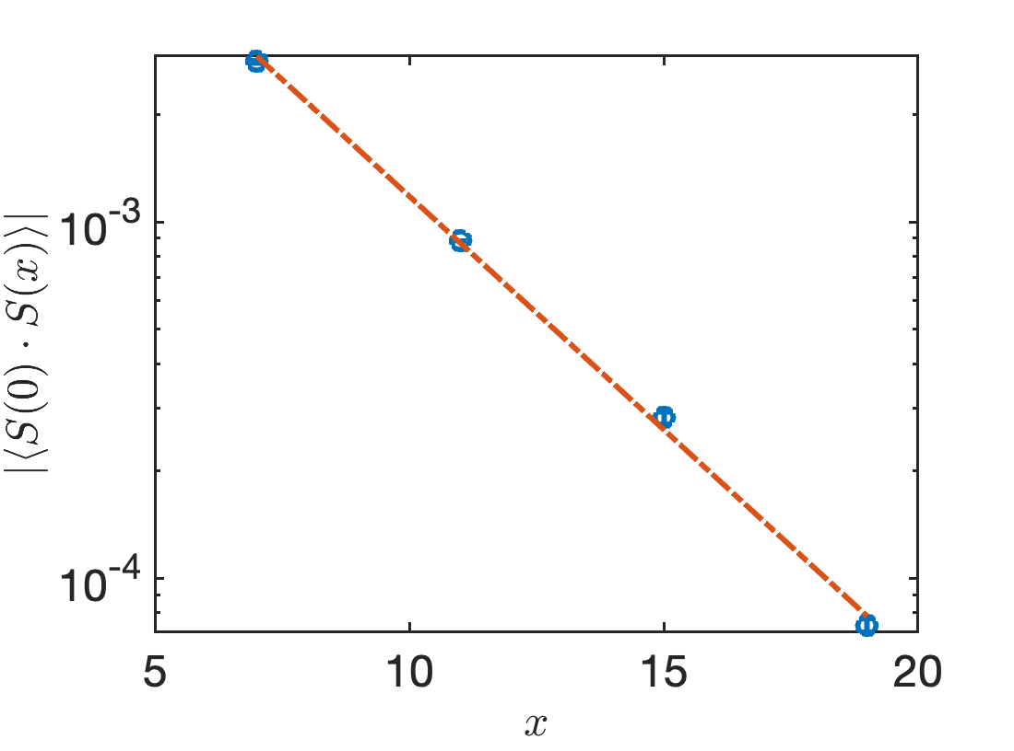
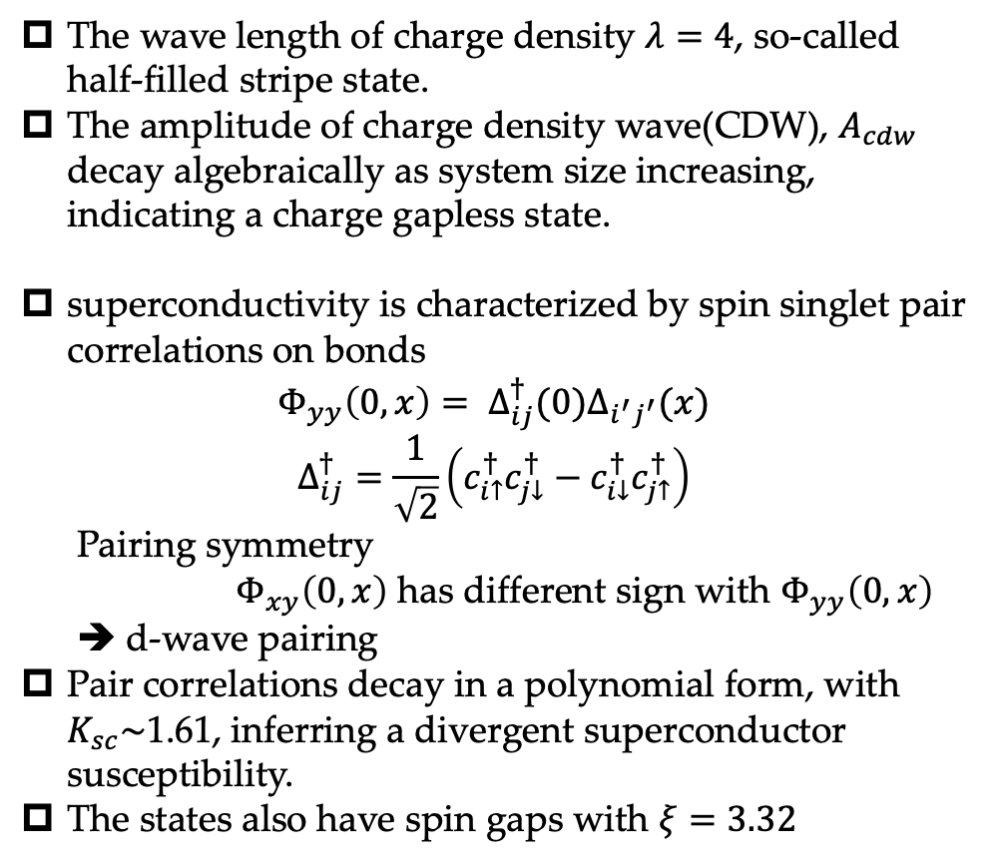
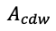
Results: SSH-Hubbard model
The wave length of charge density $λ=4$, so-called half-filled stripe state.
The amplitude of charge density wave(CDW), $A_{cdw}$ decay algebraically as system size increasing, indicating a charge gapless state.
superconductivity is characterized by spin singlet pair correlations on bonds
$$Φ_{yy}\left(0, x\right)= Δ_{ij}^{†}(0)Δ_{i^{′}j^{′}}(x)$$
$$Δ_{ij}^{†}=\frac{1}{\sqrt{2}}\left(c_{i↑}^{†}c_{j↓}^{†}−c_{i↓}^{†}c_{j↑}^{†}\right)$$
Pairing symmetry
$Φ_{xy}\left(0, x\right)$ has different sign with $Φ_{yy}\left(0, x\right)$
➔ d-wave pairing
Pair correlations decay in a polynomial form, with $K_{sc}\sim$1.61, inferring a divergent superconductor susceptibility.
The states also have spin gaps with $ξ=3.32$
$$A_{cdw}$$

Slide 10
Thanks for your listening!

Slide 11
Holstein-Hubbard model

Slide 12
Results: Holstein-Hubbard Model

Slide 13
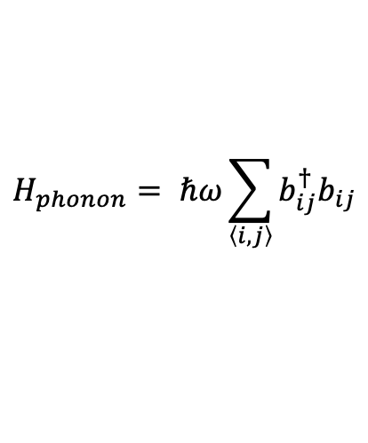
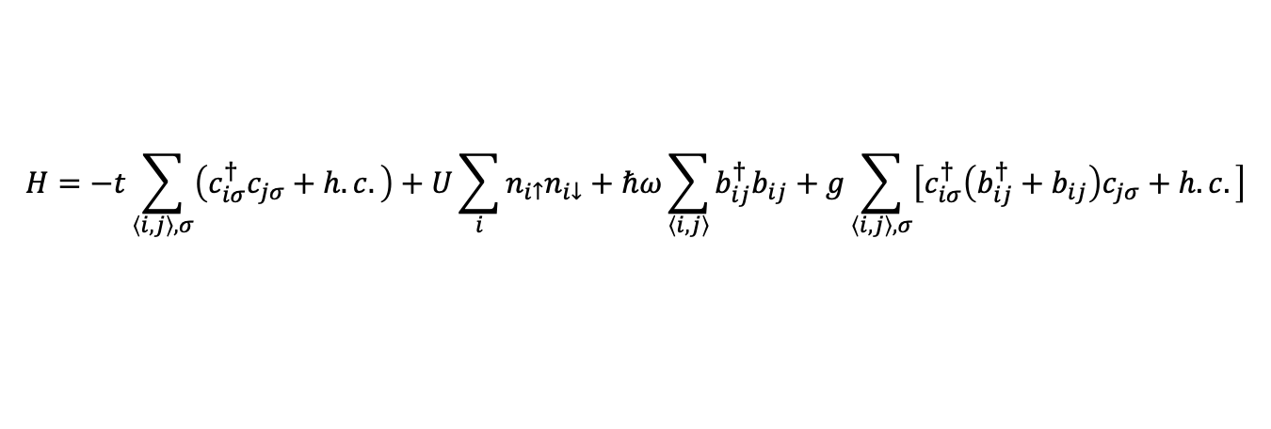
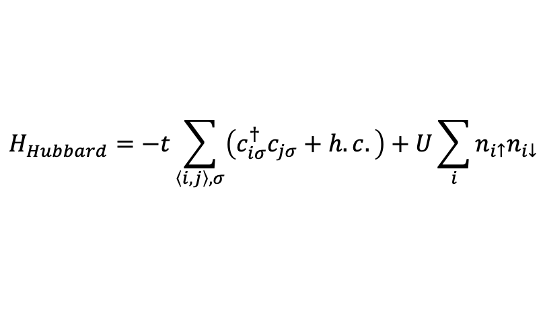
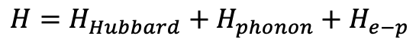
Su-Schrieffer-Heeger(SSH)-Hubbard model
$$H=H_{Hubbard}+H_{phonon}+H_{e−p}$$
$$H_{Hubbard}=−t\sum_{\left\langle i,j\right\rangle ,σ}{\left(c_{iσ}^{†}c_{jσ}+h.c.\right)}+U\sum_{i}{n_{i↑}n_{i↓}}$$
$$H_{phonon}= ℏω\sum_{\left\langle i, j\right\rangle }{b_{ij}^{†}b_{ij}}$$
$$H=−t\sum_{\left\langle i,j\right\rangle ,σ}{\left(c_{iσ}^{†}c_{jσ}+h.c.\right)}+U\sum_{i}{n_{i↑}n_{i↓}}+ℏω\sum_{\left\langle i, j\right\rangle }{b_{ij}^{†}b_{ij}}+g\sum_{\left\langle i, j\right\rangle ,σ}{\left[c_{iσ}^{†}\left(b_{ij}^{†}+b_{ij}\right)c_{jσ}+h.c.\right]}$$
Electron site (Cu)
Phonon site (O)

Slide 14
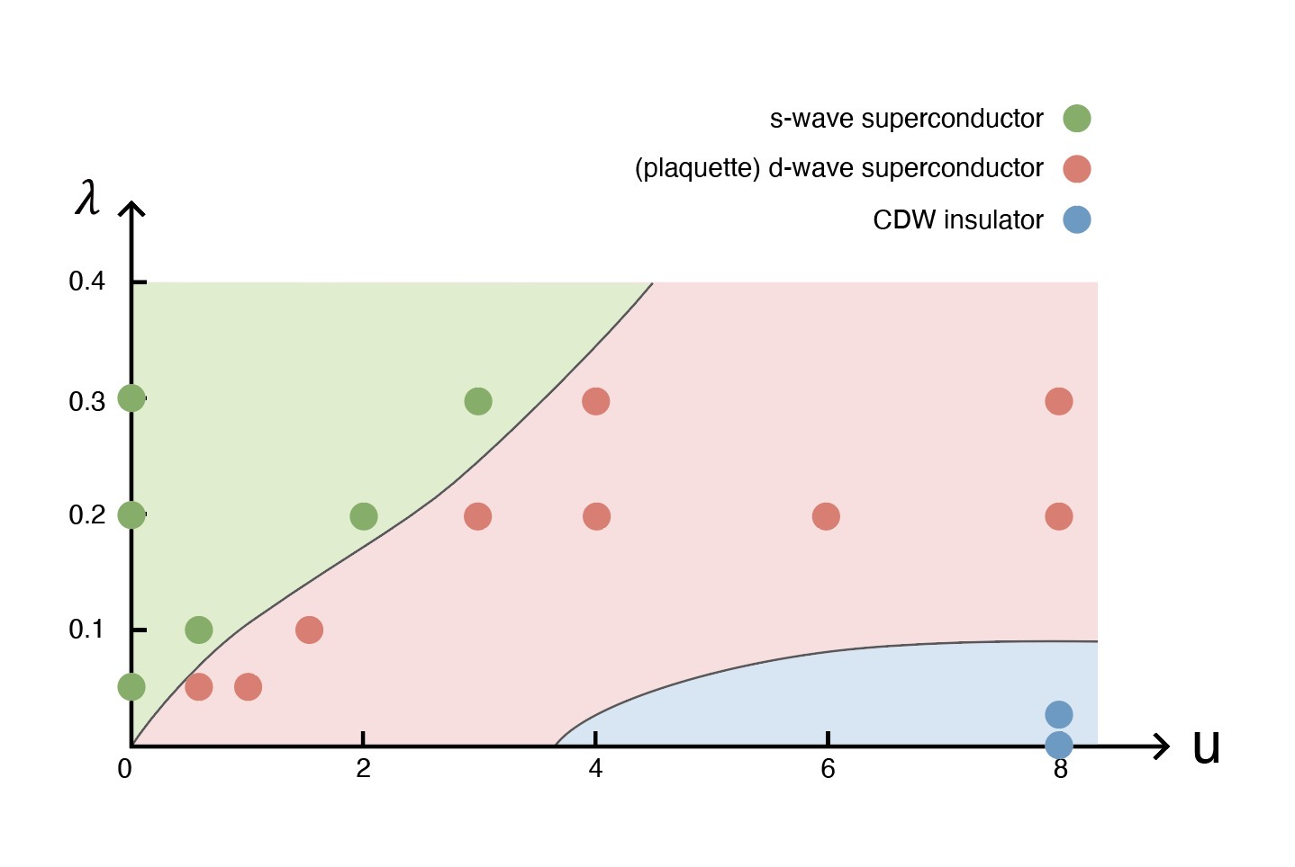
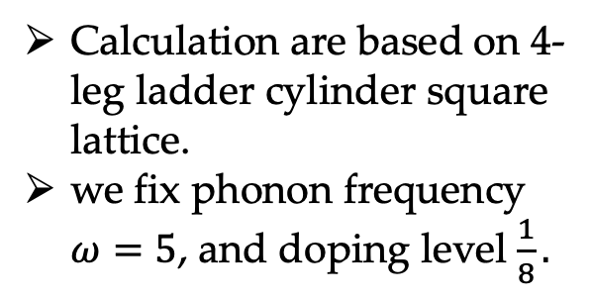
Results: SSH-Hubbard model
Phase diagram of SSH-Hubard model
Calculation are based on 4-leg ladder cylinder square lattice.
we fix phonon frequency $ω=5$, and doping level $\frac{1}{8}.$

Slide 15
Outline

